Slide 1
Unit-1 javascript
S Lakshmisri
Assistant Professor©
Dept of CSE
RGUKT-SRIKAKULAM.

Slide 2
Client-side scripting
Client-side scripting is when the server sends the code along with the HTML web page to the client. The script is referred to by the code.
In other words, client-side scripting is a method for browsers to run scripts without having to connect to a server.
The code runs on the client’s computer’s browser either while the web page is loading or after it has finished loading.
Client-side scripting is mostly used for dynamic user interface components including pull-down menus, navigation tools, animation buttons, and data validation.
It is currently quickly expanding and evolving on a daily basis. As a result, creating client-side web programming has become easier and faster, lowering server demand.

Slide 3
how does it work?
A client-side script is a tiny program (or collection of instructions) that is put into a web page. It is handled by the client browser rather than the web server.
The client-side script, along with the HTML web page it is embedded in, is downloaded from the server at the client end. The code is interpreted and executed by the web browser, which then displays the results on the screen.
The client refers to the script that runs on the user’s computer system. It can either be integrated (or injected) into the HTML content or stored in a separate file (known as an external script).
When the script files are requested, they are transmitted from the web server (or servers) to the client system. The script is run by the client’s web browser, which subsequently displays the web page, including any visible script output.

Slide 4
The following are the most popular client-side scripting languages:
1. JavaScript is the most commonly used client-side scripting or programming language. It is written in the ECMAScript programming language.
JavaScript is a dynamically typed (also known as weakly typed) object-oriented scripting language. It uses an integrated interpreter to run directly in the browser.
Weakly typed indicates that the variables can be implicitly transformed from one data type to another.
2. VBScript: This scripting language was developed by Microsoft, based on Visual Basic. It was mostly used to improve the functionality of web pages in Internet Explorer. The Internet Explorer web browser interprets VBScript. No one really uses it now.
3. jQuery: jQuery is a JavaScript library that is fast, tiny, and lightweight. It’s used to turn a lot of JavaScript code into user-friendly functionality.
The jQuery language is used by the majority of the world’s largest firms, including Google, Microsoft, IBM, Netflix, and others.

Slide 5
introduction
JavaScript is the premier client-side interpreted scripting language.
Netscape initially introduced the language under the name LiveScript in an early beta release of Navigator 2.0 in 1995, and the focus was on form validation.
After that, the language was renamed JavaScript.
After Netscape introduced JavaScript in version 2.0 of their browser, Microsoft introduced a clone of JavaScript called JScript in Internet Explorer 3.0.

Slide 6
JavaScript gives web developers a programming language for use in web pages & allows them to do the following:
→JavaScript gives HTML designers a programming tool
→JavaScript can be used to validate data
→ JavaScript can read and write HTML elements
→Create pop-up windows
→Perform mathematical calculations on data
→React to events, such as a user rolling over an image or clicking a button

Slide 7
→ Retrieve the current date and time from a user’s computer or the last time a document was modified
→Determine the user’s screen size, browser version, or screen resolution
→JavaScript can put dynamic text into an HTML page
→JavaScript can be used to create cookies

Slide 8
Changing the Elements:
<!DOCTYPE html>
<html>
<body>
<h2>What Can JavaScript Do?</h2>
<p id="demo">JavaScript can change HTML content.</p>
<button type="button" onclick='document.getElementById("demo").innerHTML = "Hello JavaScript!"'>Click Me!</button>
</body>
</html>

Slide 9
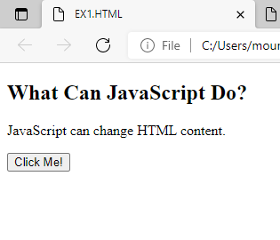
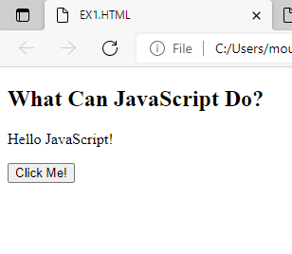

Slide 10
JavaScript Can Change HTML Attribute Values
In this example JavaScript changes the value of the src (source) attribute of an <img> tag:
Example:
<!DOCTYPE html>
<html>
<body>
<h2>What Can JavaScript Do?</h2>
<p>JavaScript can change HTML attribute values.</p>
<p>In this case JavaScript changes the value of the src (source) attribute of an image.</p>
<button onclick="document.getElementById('myImage').src='pic_bulbon.PNG'">Turn on the light</button>
<img id="myImage" src="pic_bulboff.PNG" style="width:100px">
<button onclick="document.getElementById('myImage').src='pic_bulboff.PNG'">Turn off the light</button>
</body>
</html>

Slide 11
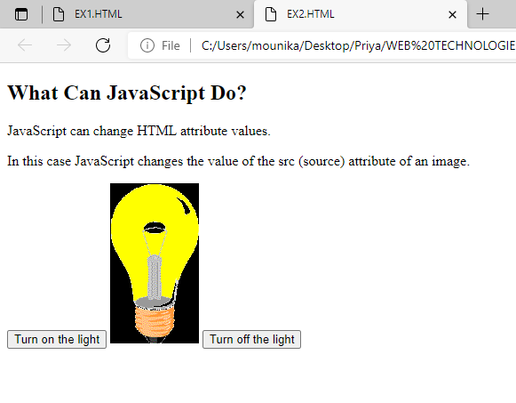
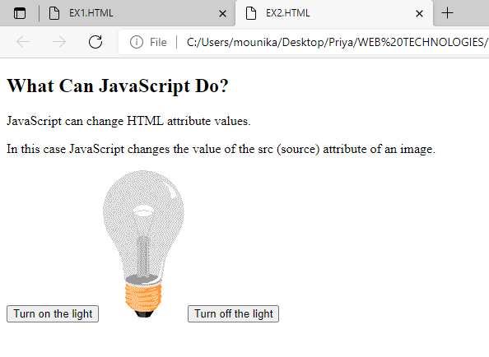

Slide 12
JavaScript Can Change HTML Styles (CSS)
<!DOCTYPE html>
<html>
<body>
<h2>What Can JavaScript Do?</h2>
<p id="demo">JavaScript can change the style of an HTML element.</p>
<button type="button" onclick="document.getElementById('demo').style.fontSize='35px'">Click Me!</button>
</body>
</html>

Slide 13
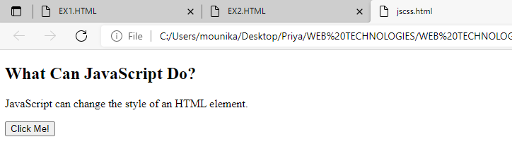
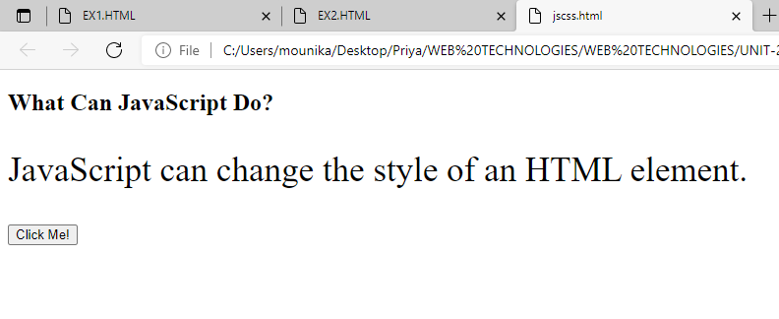

Slide 14
JavaScript Can Hide HTML Elements
<!DOCTYPE html>
<html>
<body>
<h2>What Can JavaScript Do?</h2>
<p id="demo">JavaScript can hide HTML elements.</p>
<button type="button" onclick="document.getElementById('demo').style.display='none'">Click Me!</button>
</body>
</html>

Slide 15
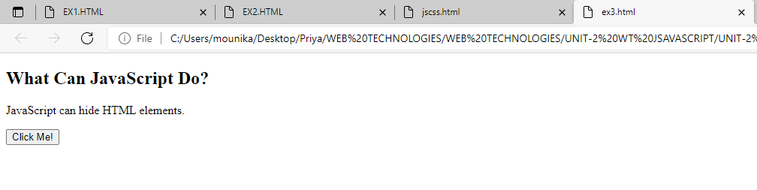
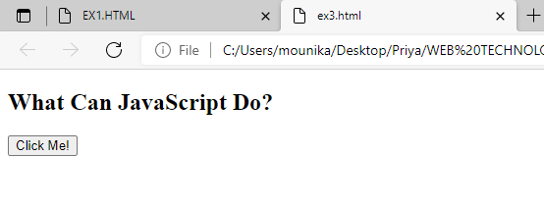

Slide 16
JavaScript Can Show HTML Elements
<!DOCTYPE html>
<html>
<body>
<h2>What Can JavaScript Do?</h2>
<p>JavaScript can show hidden HTML elements.</p>
<p id="demo" style="display:none">Hello JavaScript!</p>
<button type="button" onclick="document.getElementById('demo').style.display='block'">Click Me!</button>
</body>
</html>

Slide 17
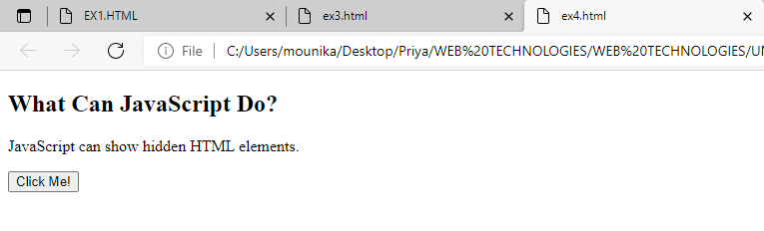
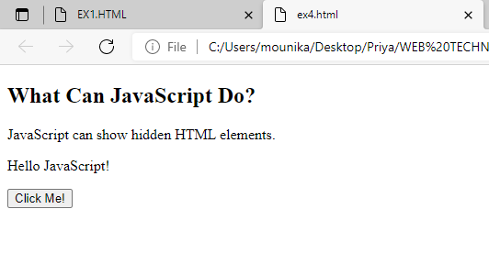

Slide 18
The <script> Tag
<!DOCTYPE html>
<html>
<body>
<h2>JavaScript in Body</h2>
<p id="demo"></p>
<script>
document.getElementById("demo").innerHTML = "My First JavaScript";
</script>
</body>
</html>

Slide 19
JavaScript in <head>
<!DOCTYPE html>
<html>
<head>
<script>
function myFunction() {
document.getElementById("demo").innerHTML = "Paragraph changed.";
}
</script>
</head>
<body>
<h2>JavaScript in Head</h2>
<p id="demo">A Paragraph.</p>
<button type="button" onclick="myFunction()">Try it</button>
</body>
</html>

Slide 20
JavaScript in <body>
<!DOCTYPE html>
<html>
<body>
<h2>JavaScript in Body</h2>
<p id="demo">A Paragraph.</p>
<button type="button" onclick="myFunction()">Try it</button>
<script>
function myFunction() {
document.getElementById("demo").innerHTML = "Paragraph changed.";
}
</script>
</body>
</html>

Slide 21
JavaScript Output
JavaScript can "display" data in different ways:
Writing into an HTML element, using innerHTML.
Writing into the HTML output using document.write().
Writing into an alert box, using window.alert().
Writing into the browser console, using console.log().
Using innerHTML
To access an HTML element, JavaScript can use the document.getElementById(id) method.
The id attribute defines the HTML element. The innerHTML property defines the HTML content:

Slide 22
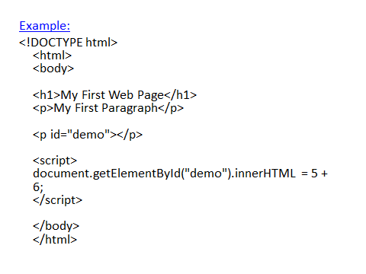

Slide 23
Using document.write()
For testing purposes, it is convenient to use document.write():
<!DOCTYPE html>
<html>
<body>
<h2>My First Web Page</h2>
<p>My first paragraph.</p>
<p>Never call document.write after the document has finished loading.
It will overwrite the whole document.</p>
<script>
document.write(5 + 6);
</script>
</body>
</html>

Slide 24
JavaScript Statements
<!DOCTYPE html>
<html>
<body>
<h2>JavaScript Statements</h2>
<p>A <b>JavaScript program</b> is a list of <b>statements</b> to be executed by a computer.</p>
<p id="demo"></p>
<script>
var x, y, z; // Statement 1
x = 5; // Statement 2
y = 6; // Statement 3
z = x + y; // Statement 4
document.getElementById("demo").innerHTML =
"The value of z is " + z + ".";
</script>
</body>
</html>

Slide 25
Advantages of JavaScript:
→Less server interaction
→ Immediate feedback to the visitors
→ Increased interactivity
→ Java Script is relatively secure.
Points to remember:
• JavaScript is case-sensitive
• Each line of code is terminated by a semicolon
• Variables are declared using the keyword var

Slide 26
JavaScript and HTML Page
Having written some JavaScript, we need to include it in an HTML page.
We can‟t execute these scripts from a command line, as the interpreter is part of the browser.
The script is included in the web page and run by the browser, usually as soon as the page has been loaded.
The browser is able to debug the script and can display errors.
Embedding JavaScript in HTML file:
If we are writing small scripts, or only use our scripts in few pages, then the easiest way is to include the script in the HTML code. The syntax is shown below:

Slide 27
<html>
<head>
<script language=”javascript”>
<!- -
Javascript code here
//- - >
</head>
<body>
……
</body>
</html>

Slide 28
Using External JavaScript in HTML file:
If we use lot of scripts, or our scripts are complex then including the code inside the web page will make the source file difficult to read and debug.
A better idea is to put the JavaScript code in a separate file and include that code in the HTML file.
By convention, JavaScript programs are stored in files with the .js extension.

Slide 29
<html>
<head>
<script language=”javascript” src=”sample.js”> </script>
</head>
<body>
……
</body>
</html>
The script tag:
The <SCRIPT> tag is an extension to HTML that can enclose any number of JavaScript statements as shown here:
<SCRIPT> JavaScript statements... </SCRIPT>
A document can have multiple SCRIPT tags, and each can enclose any number of JavaScript statements.

Slide 30
First javascript program
<!DOCTYPE html>
<html>
<body>
<script>
document.write(“Hello, World!!”);
alert(“Hello, World!!”);
</script>
</body>
</html>

Slide 31
JavaScript code in a file
The SRC attribute of the <SCRIPT> tag lets you specify a file as the JavaScript source (rather than embedding the JavaScript in the HTML).
This attribute is especially useful for sharing functions among many different pages.

Slide 32
Example:
<!DOCTYPE HTML>
<html>
<body>
<p>Before the script...</p>
<script> alert( 'Hello, world!' );
</script>
<p>...After the script.</p>
</body>
</html>

Slide 33
POPUP BOXES IN JAVASCRIPT
alert(“string”) opens box containing the message
confirm(“string”) displays a message box with OK and CANCEL buttons
prompt(“string”) displays a prompt window with field for the user to enter a text string

Slide 34
Example:
<html>
<head>
<script language="javascript">
function show_alert()
{
alert("Hi! This is alert box!!");
}
</script>
</head>
<body>
<input type="button"onclick="show_alert()" value=“Display alert box" > </input>
</body>
</html>

Slide 35
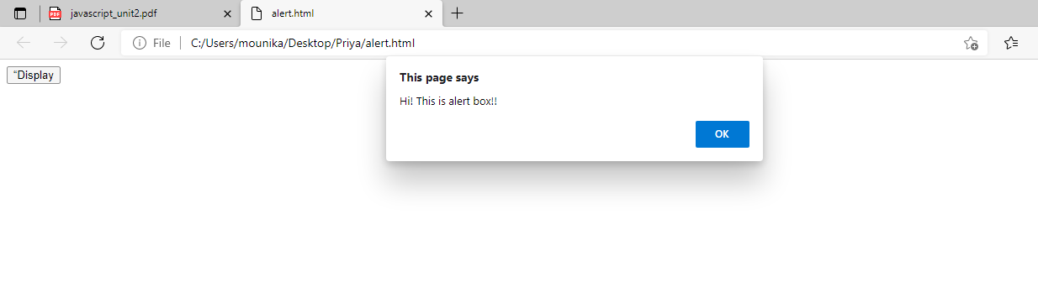
output

Slide 36
Confirm(“string”)
<!DOCTYPE html>
<html>
<body>
<h2>JavaScript Confirm Box</h2>
<button onclick="myFunction()">Try it</button>
<p id="demo"></p>
<script>
function myFunction() {
var txt;
if (confirm("Press a button!")) {
txt = "You pressed OK!";
} else {
txt = "You pressed Cancel!";
}
document.getElementById("demo").innerHTML = txt;
}
</script>
</body>
</html>

Slide 37
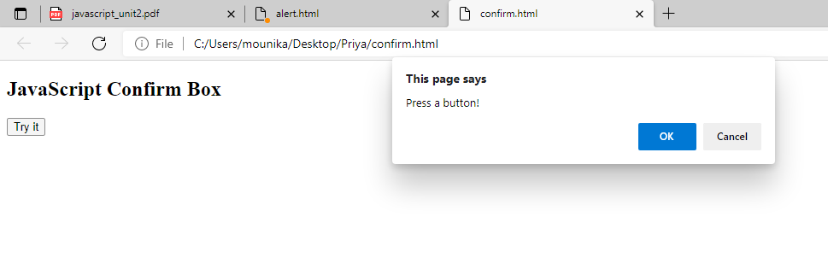

Slide 38
prompt(“string”)
<!DOCTYPE html>
<html>
<body>
<h2>JavaScript Prompt</h2>
<button onclick="myFunction()">Try it</button>
<p id="demo"></p>
<script>
function myFunction() {
let text;
let person = prompt("Please enter your name:", "Harry Potter");
if (person == null || person == "") {
text = "User cancelled the prompt.";
} else {

Slide 39
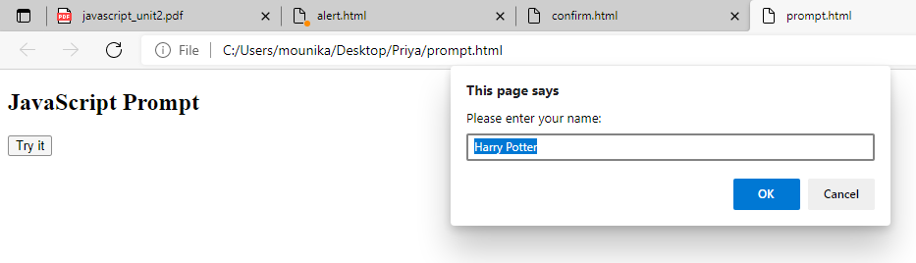
text = "Hello " + person + "! How are you today?";
}
document.getElementById("demo").innerHTML = text;
}
</script>
</body>
</html>

Slide 40
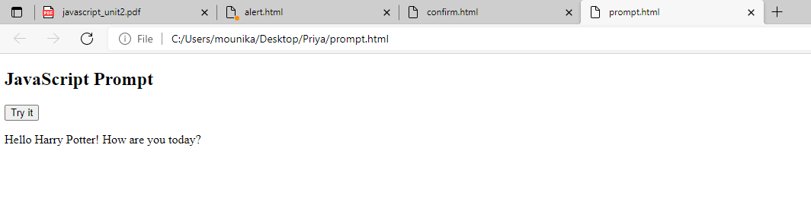

Slide 41
JavaScript Programming Elements
• Variables, datatypes , operators
• Statements
• Arrays
• Functions
• Objects in JavaScript
• Exception Handling
• Events
• Dynamic HTML with JavaScript

Slide 42
VARIABLES
A variable is a name assigned to computer memory location to store data.
As the name suggests, the value of the variable can vary, as the program runs.
We can create a variable with the var statement
var <variablename> = <some value>;
Example:
var sum = 0;
var str;
We can initialize a variable like this:
str = “hello”;

Slide 43
Rules for variable names:
# They must begin with a letter, digit or underscore character
# We can‟t use spaces in names
# Variable names are case sensitive
# We can‟t use reserved word as a variable name.
Weakly Typed Language:
→ Most high-level languages, including C and Java, are strongly typed. That is, a variable must be declared before it is used, and its type must be included in its declaration. Once a variable is declared, its type cannot be changed.
→ As the JavaScript is weakly typed language, data types are not explicitly declared.

Slide 44
Example:
var num;
num = 3;
num = "San Diego";
First, when the variable num is declared, it is empty. Its data type is actually the type undefined.
Then we assign it to the number 3, so its data type is numeric.
Next we reassign it to the string "San Diego", so the variable‟s type is now string.

Slide 45
Example:
<!DOCTYPE html>
<html>
<body>
<h2>JavaScript Variables</h2>
<p>In this example, a, b, and c are variables.</p>
<p id="demo"></p>
<script>
var a = 5;
var b = 6;
var c = a + b;
document.getElementById("demo").innerHTML =
"The value of c is: " + c;
</script>
</body>
</html>

Slide 46
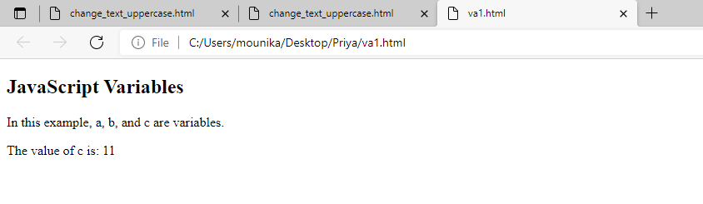

Slide 47
DATATYPES
JavaScript supports five primitive data types:
Number
String
Boolean
Undefined
Null
These types are referred to as primitive types because they are the basic building blocks from which more complex types can be built.
Of the five, only number, string, and boolean are real data types in the sense of actually storing data.
Undefined and null are types that arise under special circumstances.

Slide 48
Primitive Data Types
Numbers
Strings
Boolean (True, False)
Composite Data Types
Arrays
Objects
Numbers - A number can be either an integer or a decimal
Strings - A string is a sequence of letters or numbers enclosed in single or double quotes
Boolean - True or False

Slide 49
Although JavaScript does not have explicit data types, it does have implicit data types
If you have an expression which combines two numbers, it will evaluate to a number
If you have an expression which combines a string and a number, it will evaluate to a string

Slide 50
Example: Variables
var x = 1;
var y = 2;
var z = “abc”;
var q = “10”;
Ans = x + y;
Ans => 03
Ans = z + x;
Ans => abc1
Ans = x + q;
Ans => 110

Slide 51
var x = 4;
var y = 5;
var z = “xyz”;
var q = “17”;
Ans = x + y + z;
Ans => 9xyz
Ans = q + x + y;
Ans => 179

Slide 52
Decimal: The usual numbers which are having the base 10 are the decimal numbers
Octal: Octal literals begin with a leading zero, and they consist of digits from zero through seven. The following are all valid octal literals:
00 0777 024513600
HexaDecimal: Hexadecimal literals begin with a leading 0x, and they consist of digits from 0 through 9 and letters A through F. The following are all valid hexadecimal literals:
0x0 0XF8f00 0x1a3C5e7

Slide 53
The Concept of Data Types
<!DOCTYPE html>
<html>
<body>
<h2>JavaScript</h2>
<p>When adding a number and a string, JavaScript will treat the number as a string.</p>
<p id="demo"></p>
<script>
var x = 16 + "Volvo";
document.getElementById("demo").innerHTML = x;
</script>
</body>
</html>

Slide 54
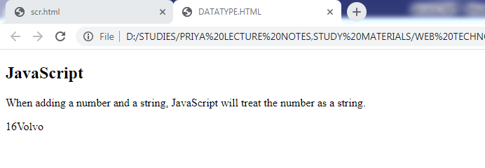

Slide 55
JavaScript Strings
A string (or a text string) is a series of characters like "John Doe".
Strings are written with quotes. You can use single or double quotes:
<!DOCTYPE html>
<html>
<body>
<h2>JavaScript Strings</h2>
<p>Strings are written with quotes. You can use single or double quotes:</p>
<p id="demo"></p>
<script>
var carName1 = "Volvo XC60";
var carName2 = 'Volvo XC60';
document.getElementById("demo").innerHTML =
carName1 + "<br>" +
carName2;
</script>
</body>
</html>

Slide 56
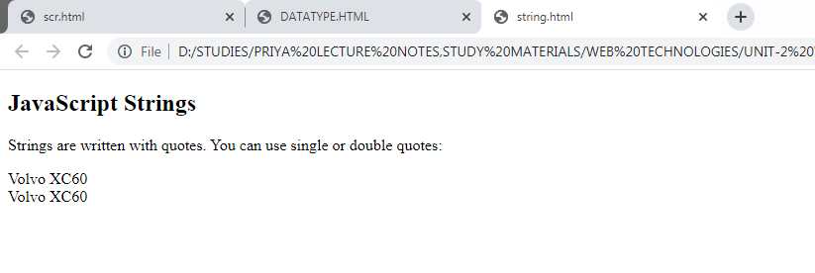

Slide 57
JavaScript Numbers
JavaScript has only one type of numbers.
Numbers can be written with, or without decimals:
<!DOCTYPE html>
<html>
<body>
<h2>JavaScript Numbers</h2>
<p>Numbers can be written with, or without decimals:</p>
<p id="demo"></p>
<script>
var x1 = 34.00;
var x2 = 34;
var x3 = 3.14;
document.getElementById("demo").innerHTML =
x1 + "<br>" + x2 + "<br>" + x3;
</script>
</body>
</html>

Slide 58
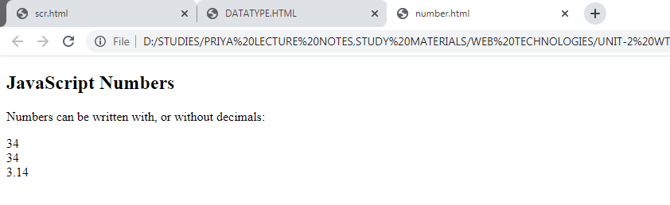

Slide 59
JavaScript Booleans
Booleans can only have two values: true or false.
<!DOCTYPE html>
<html>
<body>
<h2>JavaScript Booleans</h2>
<p>Booleans can have two values: true or false:</p>
<p id="demo"></p>
<script>
var x = 5;
var y = 5;
var z = 6;
document.getElementById("demo").innerHTML =
(x == y) + "<br>" + (x == z);
</script>
</body>
</html>

Slide 60
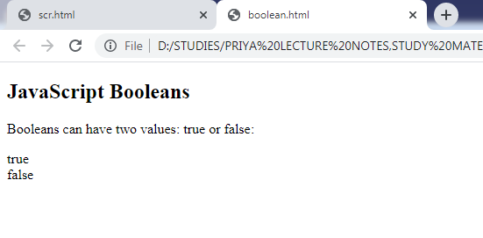

Slide 61
JavaScript Arrays
<!DOCTYPE html>
<html>
<body>
<h2>JavaScript Arrays</h2>
<p>Array indexes are zero-based, which means the first item is [0].</p>
<p id="demo"></p>
<script>
var cars = ["Saab","Volvo","BMW"];
document.getElementById("demo").innerHTML = cars[0];
</script>
</body>
</html>

Slide 62
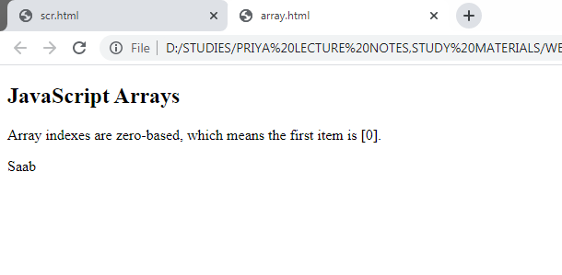

Slide 63
JavaScript Objects
<!DOCTYPE html>
<html>
<body>
<h2>JavaScript Objects</h2>
<p id="demo"></p>
<script>
var person = {
firstName : "John",
lastName : "Doe",
age : 50,
eyeColor : "blue"
};
document.getElementById("demo").innerHTML =
person.firstName + " is " + person.age + " years old.";
</script>
</body>
</html>

Slide 64
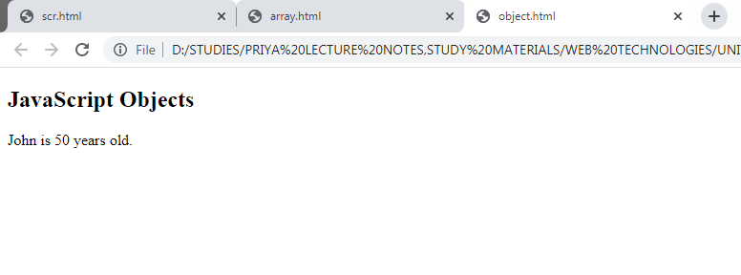

Slide 65
The typeof Operator
<!DOCTYPE html>
<html>
<body>
<h2>JavaScript typeof</h2>
<p>The typeof operator returns the type of a variable or an expression.</p>
<p id="demo"></p>
<script>
document.getElementById("demo").innerHTML =
typeof "" + "<br>" +
typeof "John" + "<br>" +
typeof "John Doe";
</script>
</body>
</html>

Slide 66
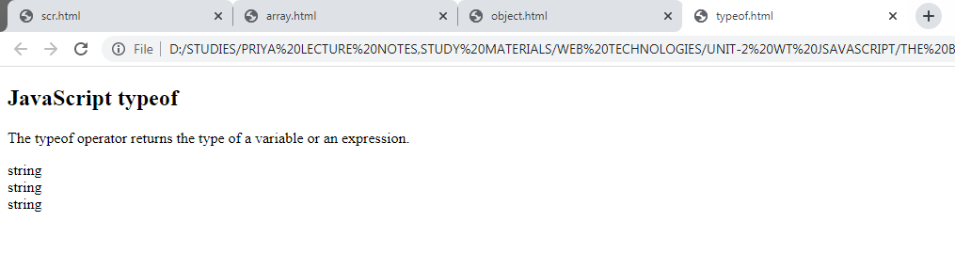

Slide 67
Primitive Data
A primitive data value is a single simple data value with no additional properties and methods.
The typeof operator can return one of these primitive types:
string
number
Boolean
undefined
<!DOCTYPE html>
<html>
<body>
<h2>JavaScript typeof</h2>
<p>The typeof operator returns the type of a variable or an expression.</p>
<p id="demo"></p>
<script>
document.getElementById("demo").innerHTML =
typeof "john" + "<br>" +
typeof 3.14 + "<br>" +
typeof true + "<br>" +
typeof false + "<br>" +
typeof x;
</script>
</body>
</html>

Slide 68
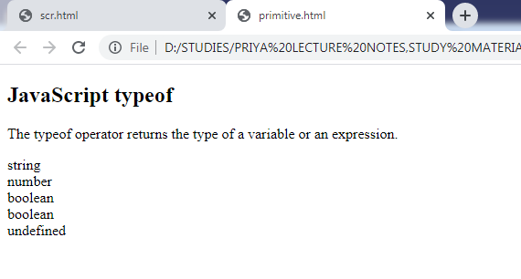

Slide 69
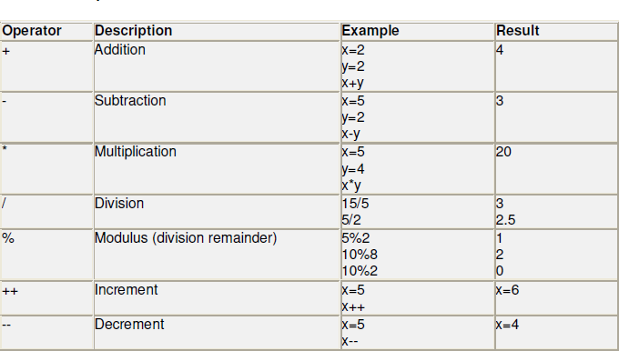
Operators in JavaScript
The operators in JavaScript can be classified as follows:
Arithmetic operators
Relational operators
Logical operators
Assignment operators
1. Arithmetic operators

Slide 70
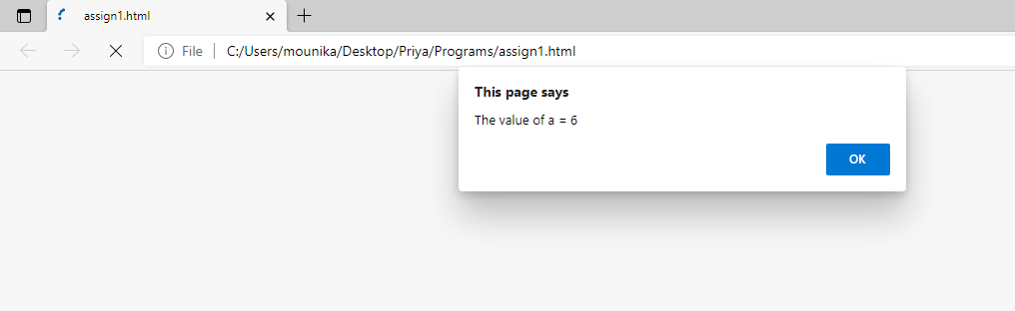
Example:
<html>
<body>
<script language="JavaScript">
<!--
var a = 5;
++a;
alert("The value of a = " + a );
-->
</script>
</body>
</html>

Slide 71
<!DOCTYPE html>
<html>
<body>
<h2>JavaScript Operators</h2>
<p>The + operator concatenates strings.</p>
<p id="demo"></p>
<script>
let text1 = "RGUKT";
let text2 = "SRIKAKULAM";
document.getElementById("demo").innerHTML = text1 + " " + text2;
</script>
</body>
</html>

Slide 72
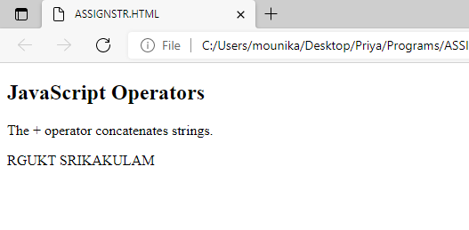

Slide 73
Example:
<html>
<body>
<script type = "text/javascript">
<!--
var a = 33;
var b = 10;
var c = "Test";
var linebreak = "<br />";
document.write("a + b = ");
result = a + b;
document.write(result);
document.write(linebreak);
document.write("a - b = ");
result = a - b;
document.write(result);
document.write(linebreak);

Slide 74
document.write("a / b = ");
result = a / b;
document.write(result);
document.write(linebreak);
document.write("a % b = ");
result = a % b;
document.write(result);
document.write(linebreak);
document.write("a + b + c = ");
result = a + b + c;
document.write(result);
document.write(linebreak);
a = ++a;
document.write("++a = ");
result = ++a;
document.write(result);
document.write(linebreak);

Slide 75
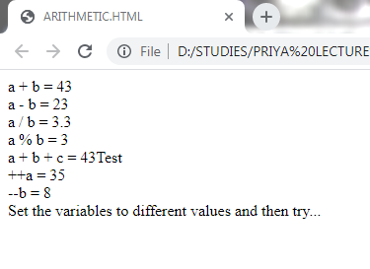
b = --b;
document.write("--b = ");
result = --b;
document.write(result);
document.write(linebreak);
//-->
</script>
Set the variables to different values and then try...
</body>
</html>

Slide 76
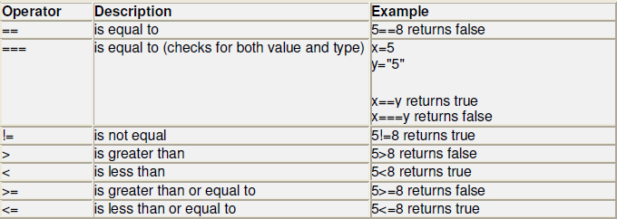
Relational operators/Comparison operators: Relational operators are used to compare quantities.

Slide 77
Example:
<html>
<body>
<script type = "text/javascript">
<!--
var a = 10;
var b = 20;
var linebreak = "<br />";
document.write("(a == b) => ");
result = (a == b);
document.write(result);
document.write(linebreak);
document.write("(a < b) => ");
result = (a < b);
document.write(result);
document.write(linebreak);
document.write("(a > b) => ");
result = (a > b);
document.write(result);
document.write(linebreak);

Slide 78
document.write("(a != b) => ");
result = (a != b);
document.write(result);
document.write(linebreak);
document.write("(a >= b) => ");
result = (a >= b);
document.write(result);
document.write(linebreak);
document.write("(a <= b) => ");
result = (a <= b);
document.write(result);
document.write(linebreak);
//-->
</script>
Set the variables to different values and different operators and then try...
</body>
</html>

Slide 79
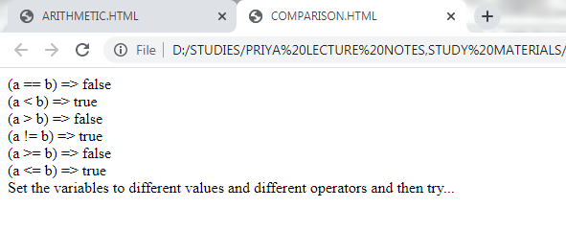

Slide 80
Logical operators:
Logical operator are used to combine two or more conditions.
<html>
<body>
<script type = "text/javascript">
<!--
var a = true;
var b = false;
var linebreak = "<br />";
document.write("(a && b) => ");
result = (a && b);
document.write(result);
document.write(linebreak);
document.write("(a || b) => ");
result = (a || b);
document.write(result);
document.write(linebreak);

Slide 81
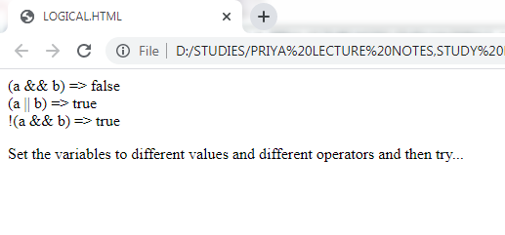
document.write("!(a && b) => ");
result = (!(a && b));
document.write(result);
document.write(linebreak);
//-->
</script>
<p>Set the variables to different values and different operators and then try...</p>
</body>
</html>

Slide 82
Assignment Operators: are used to assign the result of an expression to a variable
Example:
<html>
<body>
<script type = "text/javascript">
<!--
var a = 33;
var b = 10;
var linebreak = "<br />";
document.write("Value of a => (a = b) => ");
result = (a = b);
document.write(result);
document.write(linebreak);
document.write("Value of a => (a += b) => ");
result = (a += b);
document.write(result);
document.write(linebreak);

Slide 83
document.write("Value of a => (a -= b) => ");
result = (a -= b);
document.write(result);
document.write(linebreak);
document.write("Value of a => (a *= b) => ");
result = (a *= b);
document.write(result);
document.write(linebreak);
document.write("Value of a => (a /= b) => ");
result = (a /= b);
document.write(result);
document.write(linebreak);
document.write("Value of a => (a %= b) => ");
result = (a %= b);
document.write(result);
document.write(linebreak);
//-->
</script>
<p>Set the variables to different values and different operators and then try...</p>
</body>
</html>

Slide 84
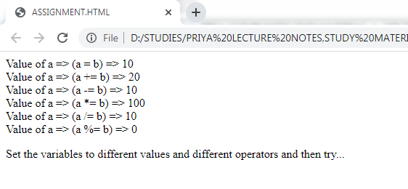

Slide 85
ARRAYS
An array is a compound data type that stores numbered pieces of data
Each numbered datum is called an element of the array and the number assigned to it is called an index.
The elements of an array may be of any type. A single array can even store elements of different type.
CREATING AN ARRAY:
There are several different ways to create an array in JavaScript
Using the Array() constructor:
- var a = new Array(1, 2, 3, 4, 5);
- var b = new Array(10);
Using array literals:
- var c = [1, 2, 3, 4, 5];

Slide 86
Accessing Array Elements
Array elements are accessed using the [ ] operator
Example:
var colors = [“red”, “green”, “blue”];
colors[0] => red
colors[1] => green
Adding Elements
To add a new element to an array, simply assign a value to it
Example:
var a = new Array(10);
a[7] = 17;

Slide 87
Array Length
All arrays created in JavaScript have a special length property that specifies how many elements the array contains
Example:
var colors = [“red”, “green”, “blue”];
colors.length => 3
Changing an Array Element
This statement changes the value of the first element in campus:
campus[1] = "Ongole";
Example:
<!DOCTYPE html>
<html>
<body>
<h2>JavaScript Arrays</h2>
<p>JavaScript array elements are accessed using numeric indexes
(starting from 0).</p>

Slide 88
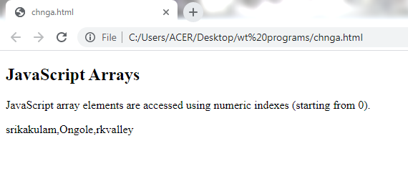
<p id="demo"></p>
<script>
var campus = ["srikakulam", "nuzvid", "rkvalley"];
campus[1] = "Ongole";
document.getElementById("demo").innerHTML = campus;
</script>
</body>
</html>

Slide 89
Array Properties and Methods
The real strength of JavaScript arrays are the built-in array properties and methods:
var x = cars.length; // The length property returns the number of elements
var y = cars.sort(); // The sort() method sorts arrays
EXAMPLE:
<!DOCTYPE html>
<html>
<body>
<h2>JavaScript Arrays</h2>
<p>The length property returns the length of an array.</p>
<p id="demo"></p>
<script>
var departments = ["cse", "ece", "mechanical", "eee"];
document.getElementById("demo").innerHTML = departments.length;
</script>
</body>
</html>

Slide 90
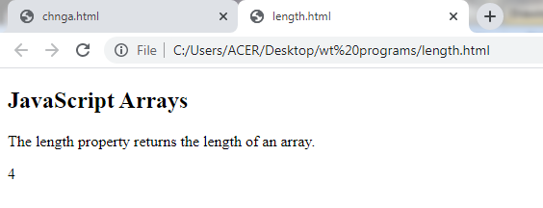
Accessing the Last Array Element
<!DOCTYPE html>
<html>
<body>
<h2>JavaScript Arrays</h2>
<p>JavaScript array elements are accesses using numeric indexes (starting from 0).</p>
<p id="demo"></p>

Slide 91
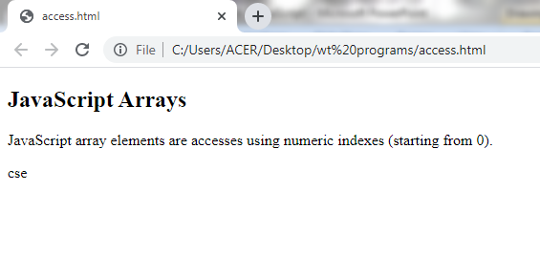
<script>
var departments = ["cse", "eee", "ece", "Mechanical"];
var last = departments[departments.length-1];
document.getElementById("demo").innerHTML = last;
</script>
</body>
</html>

Slide 92
Adding Array Elements
The easiest way to add a new element to an array is using the push() method:
<!DOCTYPE html>
<html>
<body>
<h2>JavaScript Arrays</h2>
<p>The push method appends a new element to an array.</p>
<button onclick="myFunction()">Try it</button>
<p id="demo"></p>
<script>
var campus = ["Nuzvid", "RKValley", "Srikakulam"];
document.getElementById("demo").innerHTML = campus;

Slide 93
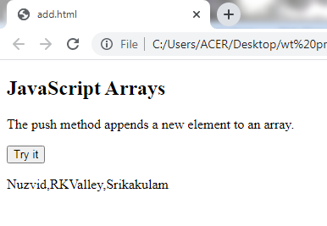
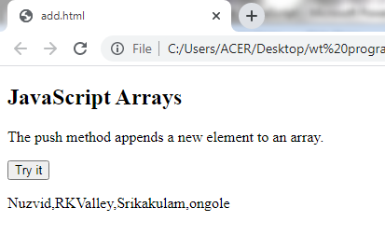
function myFunction() {
campus.push("ongole");
document.getElementById("demo").innerHTML = campus;
}
</script>
</body>
</html>

Slide 94
Associative Arrays
Many programming languages support arrays with named indexes.
Arrays with named indexes are called associative arrays (or hashes).
JavaScript does not support arrays with named indexes.
In JavaScript, arrays always use numbered indexes.
EXAMPLE:
<!DOCTYPE html>
<html>
<body>
<h2>JavaScript Arrays</h2>
<p id="demo"></p>
<script>

Slide 95
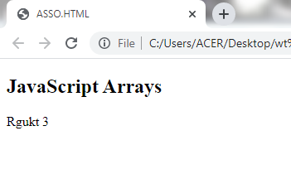
var campus = [];
campus[0] = "Rgukt";
campus[1] = "srikakulam";
campus[2] = 1;
document.getElementById("demo").innerHTML =
campus[0] + " " + campus.length;
</script>
</body>
</html>

Slide 96
Functions
Functions are a collection of JavaScript statements that performs a specified task
Functions are used whenever it is necessary to repeat an operation
Functions have inputs and outputs
The inputs are passed into the function and are known as arguments or parameters
Think of a function as a “black box” which performs an operation
A function is a JavaScript procedure--a set of statements that performs a specific task. A function definition has these basic parts:
The function keyword.
A function name.
A comma-separated list of arguments to the function in parentheses.
The statements in the function in curly braces.
No type is specified for arguments!

Slide 97
Example: Function
function square(x)
{return x*x;}
z = 3;
sqr_z = square(z);
Name of Function: square
Input/Argument: x
Output: x*x

Slide 98
JavaScript Function
JavaScript Function Syntax
A JavaScript function is defined with the function keyword, followed by a name, followed by parentheses ().
Function names can contain letters, digits, underscores, and dollar signs (same rules as variables).
The parentheses may include parameter names separated by commas: (parameter1, parameter2, ...)
The code to be executed, by the function, is placed inside curly brackets: {}
function name(parameter1, parameter2, parameter3) { // code to be executed }
Function Return
When JavaScript reaches a return statement, the function will stop executing.
If the function was invoked from a statement, JavaScript will "return" to execute the code after the invoking statement.
Functions often compute a return value. The return value is "returned" back to the "caller":

Slide 99
example
<html>
<head>
<title>Functions</title>
<script>
function square(number)
{
return number * number;
}
</script>
</head>
<body>
<script>
var x = prompt("Enter a positive integer value",0);
document.writeln("the value is ", square(x));
</script>
</body>
</html>

Slide 100
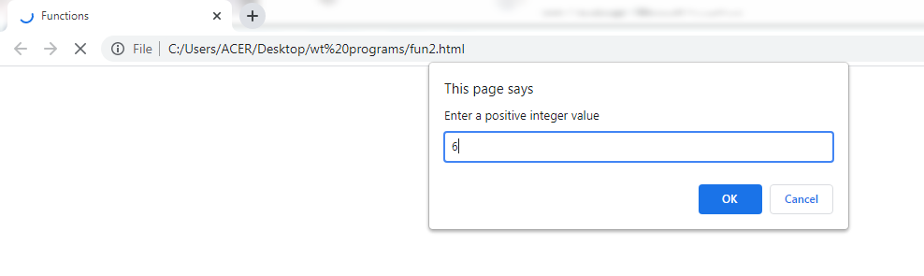
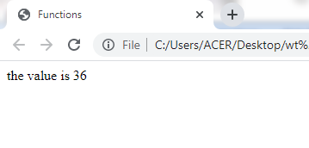

Slide 101
Function script in a file
function_square.html:
<html>
<head>
<title>Functions</title>
<script src="square.js">
</script>
</head>
<body>
<script>
var x = prompt("Enter a positive integer value",0);
document.writeln("the value is ", square(x));
</script>
</body>
</html>
square.js:
function square(number)
{
return number * number;
}

Slide 102
EXAMPLE:FACTORIAL
<head>
<title>Functions</title>
</head>
<body>
<script>
function factorial(x) {
if (x <= 0)
return(1);
else
return( x * factorial(x-1));
}
var x = prompt("Enter a positive integer
value",0);
document.write("The factorial of " + x + " is
" + factorial(x));
</script>
</body>

Slide 103
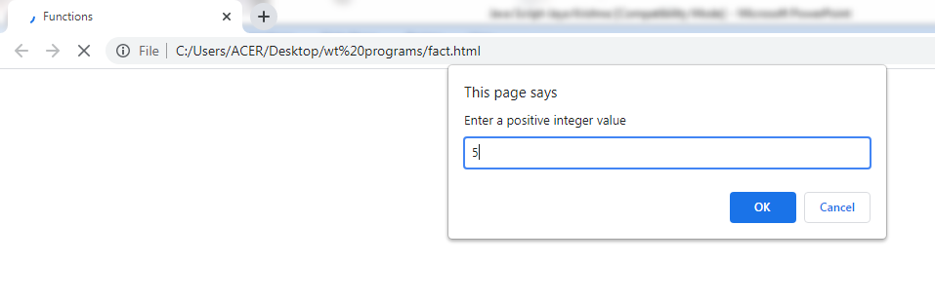
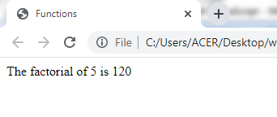

Slide 104
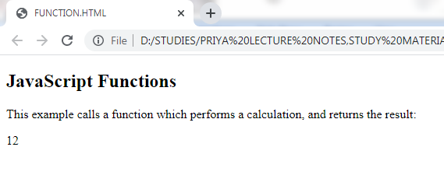
EXAMPLE:
<!DOCTYPE html>
<html>
<body>
<h2>JavaScript Functions</h2>
<p>This example calls a function which performs a calculation and returns the result:</p>
<p id="demo"></p>
<script>
var x = myFunction(4, 3);
document.getElementById("demo").innerHTML = x;
function myFunction(a, b) {
return a * b;
}
</script>
</body>
</html>

Slide 105
JavaScript Functions
A JavaScript function is a block of code designed to perform a particular task.
A JavaScript function is executed when "something" invokes it (calls it).
<!DOCTYPE html>
<html>
<body>
<h2>JavaScript Functions</h2>
<p>This example calls a function which performs a calculation, and returns the result:</p>
<p id="demo"></p>
<script>
function myFunction(p1, p2) {
return p1 * p2;
}
document.getElementById("demo").innerHTML = myFunction(4, 3);
</script>
</body>
</html>

Slide 106
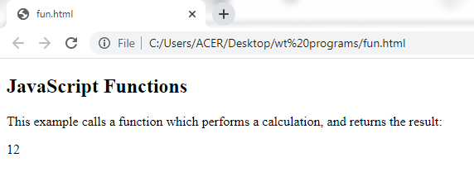

Slide 107
Conditional Statements
There are three basic types of control structures in JavaScript: the if statement, the while loop, and the for loop
Each control structure manipulates a block of JavaScript expressions beginning with { and ending with }
In JavaScript we have the following conditional statements:
if to specify a block of code to be executed, if the specified condition is true
else to specify a block of code to be executed, if the same condition is false
else if to specify a new condition to test, if the first condition is false
switch to specify many alternative blocks of code to be executed
The If Statement
If ( x = = 10)
{ y = x*x;
}
else
{ x = 0;
}
The if statement allows JavaScript programmers to a make decision

Slide 108
example
<html>
<body>
<script type = "text/javascript">
var age = 20;
if( age > 18 ) {
document.write("<b>Eligible to Vote </b>");
}
</script>
</body>
</html>

Slide 109
if...else statement
The 'if...else' statement is the next form of control statement that allows JavaScript to execute statements in a more controlled way.
Syntax
if (expression){
Statement(s) to be executed if expression is true }
Else{
Statement(s) to be executed if expression is false }
Here JavaScript expression is evaluated. If the resulting value is true, the given statement(s) in the ‘if’ block, are executed. If the expression is false, then the given statement(s) in the else block are executed.

Slide 110
EXAMPLE
<html>
<body>
<script type = "text/javascript">
var age = 25;
if( age > 18 ) {
document.write("<b>Eligible to Vote</b>");
} else {
document.write("<b>Not Eligible to Vote</b>");
}
</script>
</body>
</html>

Slide 111
if...else if... statement
The if...else if... statement is an advanced form of if…else that allows JavaScript to make a correct decision out of several conditions.
Syntax
The syntax of an if-else-if statement is as follows −
if (expression 1) {
Statement(s) to be executed if expression 1 is true
} else if (expression 2) {
Statement(s) to be executed if expression 2 is true
} else if (expression 3) {
Statement(s) to be executed if expression 3 is true
} else {
Statement(s) to be executed if no expression is true
}
if is a part of the else clause of the previous statement. Statement(s) are executed based on the true condition, if none of the conditions is true, then the else block is executed.

Slide 112
EXAMPLE
<html>
<body>
<script type = "text/javascript">
var dept = "CSE";
if( dept == "ece" ) {
document.write("<b>ece</b>");
} else if( dept == "CSE" ) {
document.write("<b>CSE</b>");
} else if( dept == "CIVIL" ) {
document.write("<b>CIVIL</b>");
} else {
document.write("<b>Unknown</b>");
}
</script>
</body>
</html>

Slide 113
Switch case
The objective of a switch statement is to give an expression to evaluate and several different statements to execute based on the value of the expression. The interpreter checks each case against the value of the expression until a match is found. If nothing matches, a default condition will be used.
SYNTAX:
switch (expression) {
case condition 1: statement(s)
break;
case condition 2: statement(s)
break;
...
case condition n: statement(s)
break;
default: statement(s)
}

Slide 114
Repeat Loops
A repeat loop is a group of statements that is repeated until a specified condition is met
Repeat loops are very powerful programming tools; They allow for more efficient program design and are ideally suited for working with arrays.
The While Loop
count = 0;
while (count <= 10) {
document.write(count);
count++;
}
The while loop is used to execute a block of code while a certain condition is true

Slide 115
example
<!DOCTYPE html>
<html>
<body>
<h2>JavaScript While Loop</h2>
<p id="demo"></p>
<script>
let text = "";
let i = 0;
while (i < 10) {
text += "<br>The number is " + i;
i++;
}
document.getElementById("demo").innerHTML = text;
</script>
</body>
</html>

Slide 116
The For Loop
The 'for' loop is the most compact form of looping. It includes the following three important parts −
The loop initialization where we initialize our counter to a starting value. The initialization statement is executed before the loop begins.
The test statement which will test if a given condition is true or not. If the condition is true, then the code given inside the loop will be executed, otherwise the control will come out of the loop.
The iteration statement where you can increase or decrease your counter.
You can put all the three parts in a single line separated by semicolons.
Syntax
The syntax of for loop is JavaScript is as follows −
for (initialization; test condition; iteration statement) {
Statement(s) to be executed if test condition is true
}

Slide 117
Example: For Loop
// Print the numbers 1 through 10
for (i=1; i<= 10; i++)
document.write(i);
i=1 initializes the counter
i<=10 is the target
value
i++ updates the
counter at the end
of the loop
<SCRIPT>
document.write("1");
document.write("2");
document.write("3");
document.write("4");
document.write("5");
</SCRIPT>
<SCRIPT>
for (i=1; i<=5; i++)
document.write(i);

Slide 118
example
<!DOCTYPE html>
<html>
<body>
<h2>JavaScript For Loop</h2>
<p id="demo"></p>
<script>
const dept = ["CSE", "CIVIL", "ECE", "EEE", "EIE", "MECHANICAL"];
let text = "";
for (let i = 0; i < dept.length; i++) {
text += dept[i] + "<br>";
}
document.getElementById("demo").innerHTML = text;
</script>
</body>
</html>

Slide 119
Objects
Objects have attributes and methods.
Many pre-defined objects and object types.
Using objects follows the syntax of C++/Java:
objectname.attributename
objectname.methodname()
The document Object
Many attributes of the current document are available via the document object:
Title URL Images
Forms Links Colors

Slide 120
The document Methods
document.links | Returns a collection of all <a> and <area> elements in the document that have a href attribute
document.title | Sets or returns the title of the document
document.URL | Returns the full URL of the HTML document
document.write() | Writes HTML expressions or JavaScript code to a document
document.writeln() | Same as write(), but adds a newline character after each statement
document.write() like a print statement – the output goes into the HTML document.
document.writeln() adds a newline after printing.
document.write("My title is" + document.title);

Slide 121
The Math Object
Access to mathematical functions and constants.
Constants: Math.PI
Methods:
Math.abs(), Math.sin(), Math.log(), Math.max(), Math.pow(), Math.random(), Math.sqrt(), …
Creating Array Objects
With the new operator and a size:
var x = new Array(10);
With the new operator and an initial set of element values:
var y = new Array(18,”hi”,22);
Assignment of an array literal
var x = [1,0,2];

Slide 122
JavaScript Objects
JavaScript is an Object Oriented Programming (OOP) language.
Objects are composed of attributes. If an attribute contains a function, it is considered to be a method of the object.
The syntax for adding a property to an object is:
objectName.objectProperty = propertyValue;
document.write("This is test");--------object method
User-defined Objects
All user-defined objects and built-in objects are descendants of an object called Object.
The new operator is used to create an instance of an object.
To create an object, the new operator is followed by the constructor method.
More Objects
The constructor methods are Object(), Array(), and Date() and String(). These constructors are built-in JavaScript functions.

Slide 123
var employee = new Object();
var books = new Array("C++", "Perl", "Java");
var day = new Date("August 15, 1947");
Objects are variables too. But objects can contain many values.
The values are written as name : value pairs (name and value separated by a colon).
Object Definition
You define (and create) a JavaScript object with an object literal:
Example
var person = {firstName:"John", lastName:"Doe", age:50, eyeColor:"blue"};
Spaces and line breaks are not important. An object definition can span multiple lines:
var person = { firstName: "John", lastName: "Doe", age: 50, eyeColor: "blue" };

Slide 124
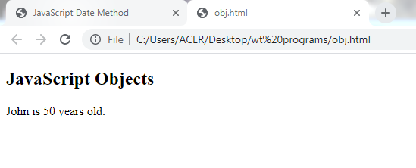
EXAMPLE:
<!DOCTYPE html>
<html>
<body>
<h2>JavaScript Objects</h2>
<p id="demo"></p>
<script>
// Create an object:
var person = {firstName:"John", lastName:"Doe", age:50, eyeColor:"blue"};
// Display some data from the object:
document.getElementById("demo").innerHTML =
person.firstName + " is " + person.age + " years old.";
</script>
</body>
</html>

Slide 125
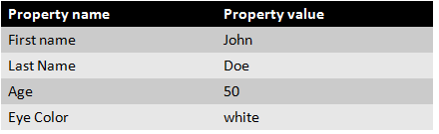
Object Properties
The name:values pairs in JavaScript objects are called properties:
Accessing Object Properties
You can access object properties in two ways:
(i) objectName.propertyName
Eg: person.lastName;
(ii) objectName["propertyName"]
Eg: person["lastName"];
Object Methods
Objects can also have methods.
Methods are actions that can be performed on objects.
Methods are stored in properties as function definitions

Slide 126
Example: fullNamefunction() -- {return this.firstName + " " + this.lastName;}
A method is a function stored as a property.
var person = { firstName: "John", lastName : "Doe", id : 5566, fullName : function() { return this.firstName + " " + this.lastName; } };
The this Keyword
In a function definition, this refers to the "owner" of the function.
In the example above, this is the person object that "owns" the fullName function.
In other words, this.firstName means the firstName property of this object.
Accessing Object Methods:You access an object method with the following syntax:
objectName.methodName()

Slide 127
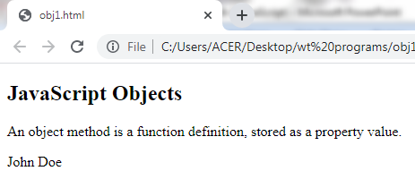
Example:
<!DOCTYPE html>
<html>
<body>
<h2>JavaScript Objects</h2>
<p>An object method is a function definition, stored as a property
value.</p>
<p id="demo"></p>
<script>
// Create an object:
var person = {
firstName: "John",
lastName : "Doe",
id : 5566,
fullName : function() {
return this.firstName + " " + this.lastName;
}
};
// Display data from the object:
document.getElementById("demo").innerHTML = person.fullName();
</script>
</body>
</html>

Slide 128
JavaScript - Document Object Model or DOM
Every web page resides inside a browser window which can be considered as an object.
A Document object represents the HTML document that is displayed in that window.
The way a document content is accessed and modified is called the Document Object Model, or DOM.
The Objects are organized in a hierarchy.
Window object − Top of the hierarchy. It is the outmost element
Document object − Each HTML document that gets loaded into a window becomes a document object.
Form object − Everything enclosed in the <form>...</form> tags
Form control elements − All the elements such as text fields, buttons, radio buttons, and checkboxes.

Slide 129
Common Methods and Properties
Finding HTML Elements
getElementById(): To access elements and attributes with id
innerHTML: To access the content of an element.
getElementsByTagName()
document.getElementsByClassName(name, value)
createElement: To create new element
removeChild: Remove an element
an event handler to a particular element like this:
document.getElementById(id).addEventListener("click", functionname)
Example:
<html>
<head> <title>DOM!!!</title></head>
<body>
<p>This is the welcome message.</p>

Slide 130
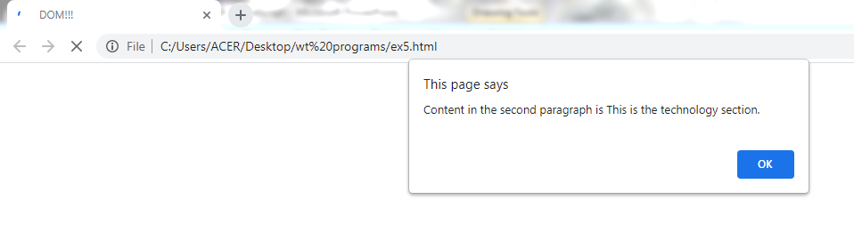
<p id="second">This is the technology section.</p>
<input type="button" id="btnClick" value="Click Me!!" />
<script type="text/javascript">
var paragraphs = document.getElementsByTagName("p");
alert("Content in the second paragraph is " + paragraphs[1].innerHTML);
document.getElementById("second").innerHTML = "The orginal message is changed.";
document.getElementById("btnClick").addEventListener("click", clicked);
function clicked() { alert("You clicked me!!!"); }
</script>
</body>
</html>

Slide 131
Changing HTML Elements
Method Description
element.innerHTML = new html content
element.attribute = new value
element.setAttribute(attribute, value)
element.style.property = new style
Adding and Deleting Elements
document.createElement(element)
document.removeChild(element)
document.appendChild(element)
document.replaceChild(element)
document.write(text)
JavaScript HTML DOM Events Examples of HTML events:
When a user clicks the mouse
When a web page has loaded

Slide 132
When an image has been loaded
When the mouse moves over an element
When an input field is changed
When an HTML form is submitted
When an reset button is clicked.
When focused on an element.

